Slide 1
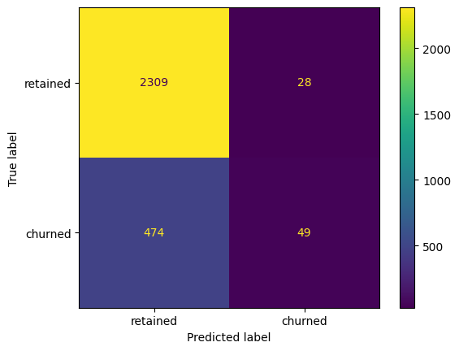
Predicts user churn project . Logistic regression
Executive summary report
Waze data Team was asked to analyze and interpret data, generate valuable insights, and help leadership make informed business decisions. The project is dedicated to help prevent user churn on the Waze app. Churn quantifies the number of users who have uninstalled the Waze app or stopped using the app. At this stage of the project data Team perform Exploratory Data Analysis and provide detailed inside about findings
The model had decent predictive power
Model precision score: 0.64
Model recall score: 0.09
Model accuracy score: 0.82
Model f1-score: 0.16
Number of days the user opens the app during the month has the most influence on either user will “Churn” or not. But this incfluece not strong enough to predict “churn” with good probability
An occurrence of driving at least 1 km during the month was expected to have more influence on “churn” status, although model shows that this variable has little effect on predictions
It is not recommended to use current model for on “churn” status prediction but to use as a reference point for future improvements
Upper-left: the number of users with rightly predicted “retained” status.
Upper-right: the number of users with wrongly predicted status (“churned” status instead of “retained” status).
Lower-left: the number of users with wrongly predicted status (“retained status instead of “churned” status).
Lower-right: the number of users with rightly predicted “churned” status.
It is recommended to continue improving logistic regression model to get better performance
In order to improve model performance it is important to collect additional data with different features regarding users activity, like location, support conditions and related to custom service information

